Slide 1
sharexpress
A Privacy-First QR-Based File Sharing & Document Editing System
Presented by:
Santusht Kotai &
Samriddhi Chaudhrary
- EN23CS301927 & EN23CS301916
Presented to:
Prof. Shivani patnaha
Guided by:
Miss.‬Monika Sadashiv

Slide 2
Table of Contents
Abstract
Literature Review
Problem Statement
Objectives
Methodology
Technology Stack
System Workflow & Architecture
Core Features
Security and Privacy
Uniqueness & Real-World Relevance
Summary and Conclusion

Slide 3
Abstract
Sharexpress is a privacy-first, QR-based file sharing and document editing web system designed to enable secure data exchange between devices without requiring application installation, contact exchange, or permanent public links. The system supports both guest and registered users and allows users to share, edit, and revoke access to files through backend-controlled, time-bound sharing sessions. By integrating QR-based session pairing, cloud storage, and on-the-go document editing, Sharexpress addresses real-world privacy, usability, and security challenges faced in everyday file sharing scenarios.

Slide 4
Literature Review
Existing file-sharing solutions such as messaging platforms, email attachments, and cloud-based sharing links rely heavily on permanent identifiers like phone numbers, email addresses, or public URLs. While operating system-level solutions like AirDrop provide fast transfers, they are platform-dependent and limited to specific ecosystems. Traditional cloud storage services also lack temporary access control and integrated editing for guest users. These limitations highlight the need for a cross-platform, privacy-focused, session-based sharing system that minimises data exposure and simplifies document handling.

Slide 5
Problem Statement
Current file-sharing methods:
Require contact exchange or permanent links
Expose sensitive documents on third-party platforms
Do not support quick document editing before sharing or printing
Force users to install applications or register accounts
These limitations create privacy risks and unnecessary complexity, especially in real-world environments such as print shops, laboratories, shared offices, and educational institutions.

Slide 6
Objective
To design a secure, QR-based/Scan-based file sharing system
To eliminate the need for contact exchange and app installation
To support both guest and registered users
To enable on-the-go document editing with version control
To implement backend-controlled, time-bound access
To ensure privacy, security, and automatic data cleanup

Slide 7
Methodology
The system is developed using an object-oriented and backend-driven approach. Authentication and session management are handled server-side. QR codes are generated with opaque tokens and resolved by the backend to create secure sharing sessions. Files are stored in cloud storage, while metadata and session information are maintained in the database. Access control, permissions, and lifecycle management are enforced through backend logic, ensuring secure and controlled interactions.

Slide 8
Technology Stack
Backend: FastAPI (Python)
Database: MongoDB, Postgres, DynamoDB
Storage: S3-Compatible Object Storage,
Authentication: Google OAuth & OTP-based login
Frontend: Vite + React
Real-Time Communication: WebSockets, p2p sockets

Slide 9
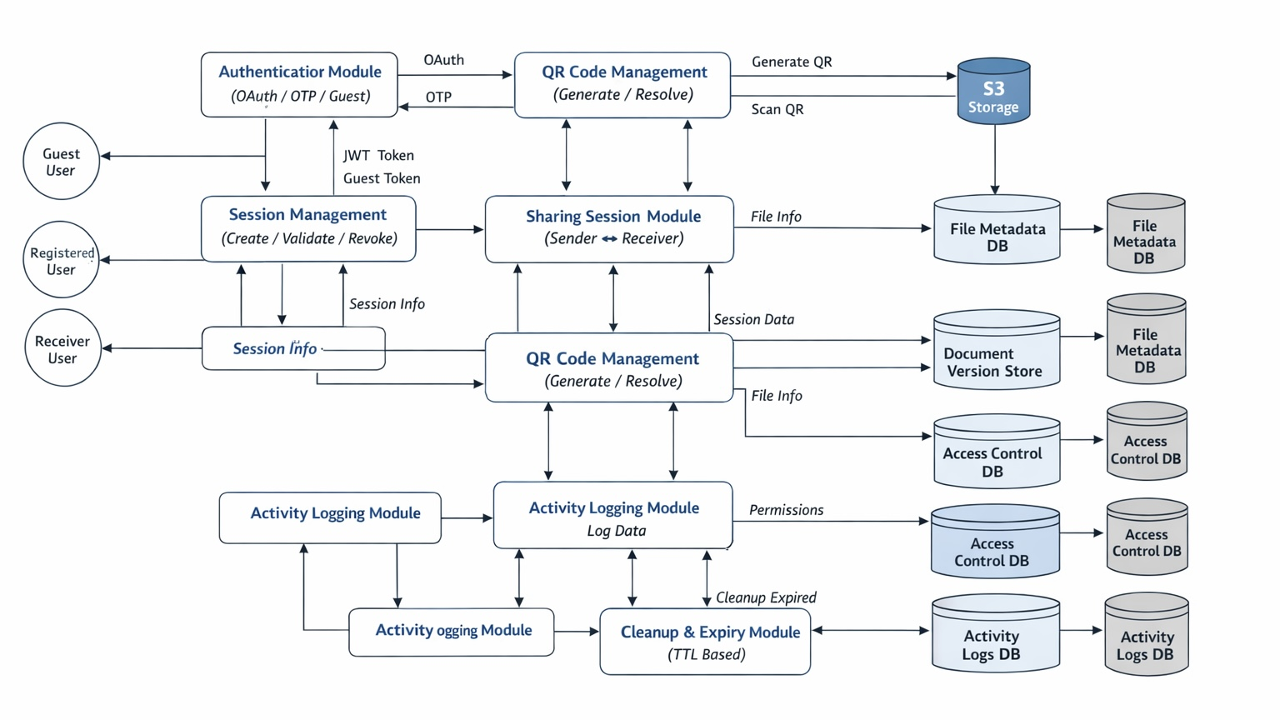
System Workflows & Architecture

Slide 10
Core Features
QR-based secure file sharing
Guest and registered user support
Session-based access control
On-the-go document editing and versioning
Access revocation and auto-expiry
Limited cloud storage for authenticated users
Activity tracking and cleanup

Slide 11
Security and Privacy
QR codes contain only opaque tokens
No JWT, user ID, or personal data in QR
Backend-controlled access and permissions
Time-bound sessions with expiry
Automatic deletion of guest data
No permanent public file URLs

Slide 12
Uniqueness & Real-World Relevance
Unlike traditional mini projects, Sharexpress solves a real-world problem by combining secure QR-based session pairing, document editing, and controlled file sharing into a single system. It does not rely on static links or contact-based sharing and supports real-life use cases such as document printing, temporary collaboration, and secure file exchange in public or shared environments. The backend-driven architecture makes it scalable, secure, and practical for real-world deployment.

Slide 13
Summary and Conclusion
Sharexpress demonstrates a modern, secure, and privacy-focused approach to file sharing and document editing. By leveraging QR-based session management, backend-driven access control, and cloud storage, the system overcomes limitations of traditional sharing methods. The project reflects real-world system design principles and provides a practical solution beyond the scope of a typical academic mini project.

Slide 14
Thank You!

